Slide 1
Introduction to R
Notes:
This is a 1 hour talk

Slide 2
R-project Background
Origin and History
Initially written by Ross Ihaka and Robert Gentleman at Dep. of Statistics of U of Auckland, New Zealand during 1990s.
An offspring of S: Bell Labs, interactive Fortran/C
International project since 1997/Beta release 200
Explosive growth last 10 years
Open source with GPL license
Free as in beer
In active development *
http://www.r-project.org/

Slide 3
R Core
R is an interactive programming environment for statistical and data analysis computations.
Core Package
Statistical functions
Plotting and graphics
Data handling and storage
predefined data reader
textual, regular expressions
hashing
Data analysis functions
Programming support:
loops, branching, subroutines
Object Oriented
Extensive community contributed packages.

Slide 4
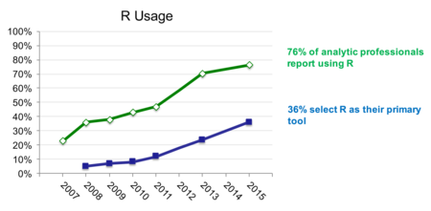
R’s Popularity
http://www.r-bloggers.com/new-surveys-show-continued-popularity-of-r/
Notes:
Data scientist survey

Slide 5
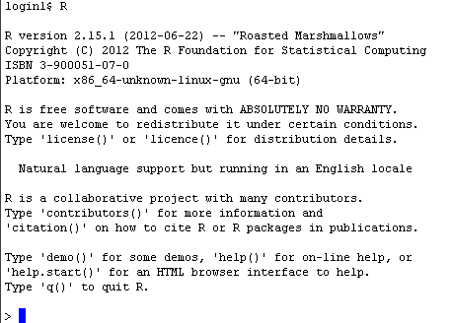
R Command Line

Slide 6
RStudio
RStudio is an open source graphical user environment for R users.
https://www.rstudio.com/
RStudio allow users to
Interactive code development
Run R scripts
Exploring local file system
Viewing data file
Viewing graphical output from R
…

Slide 7
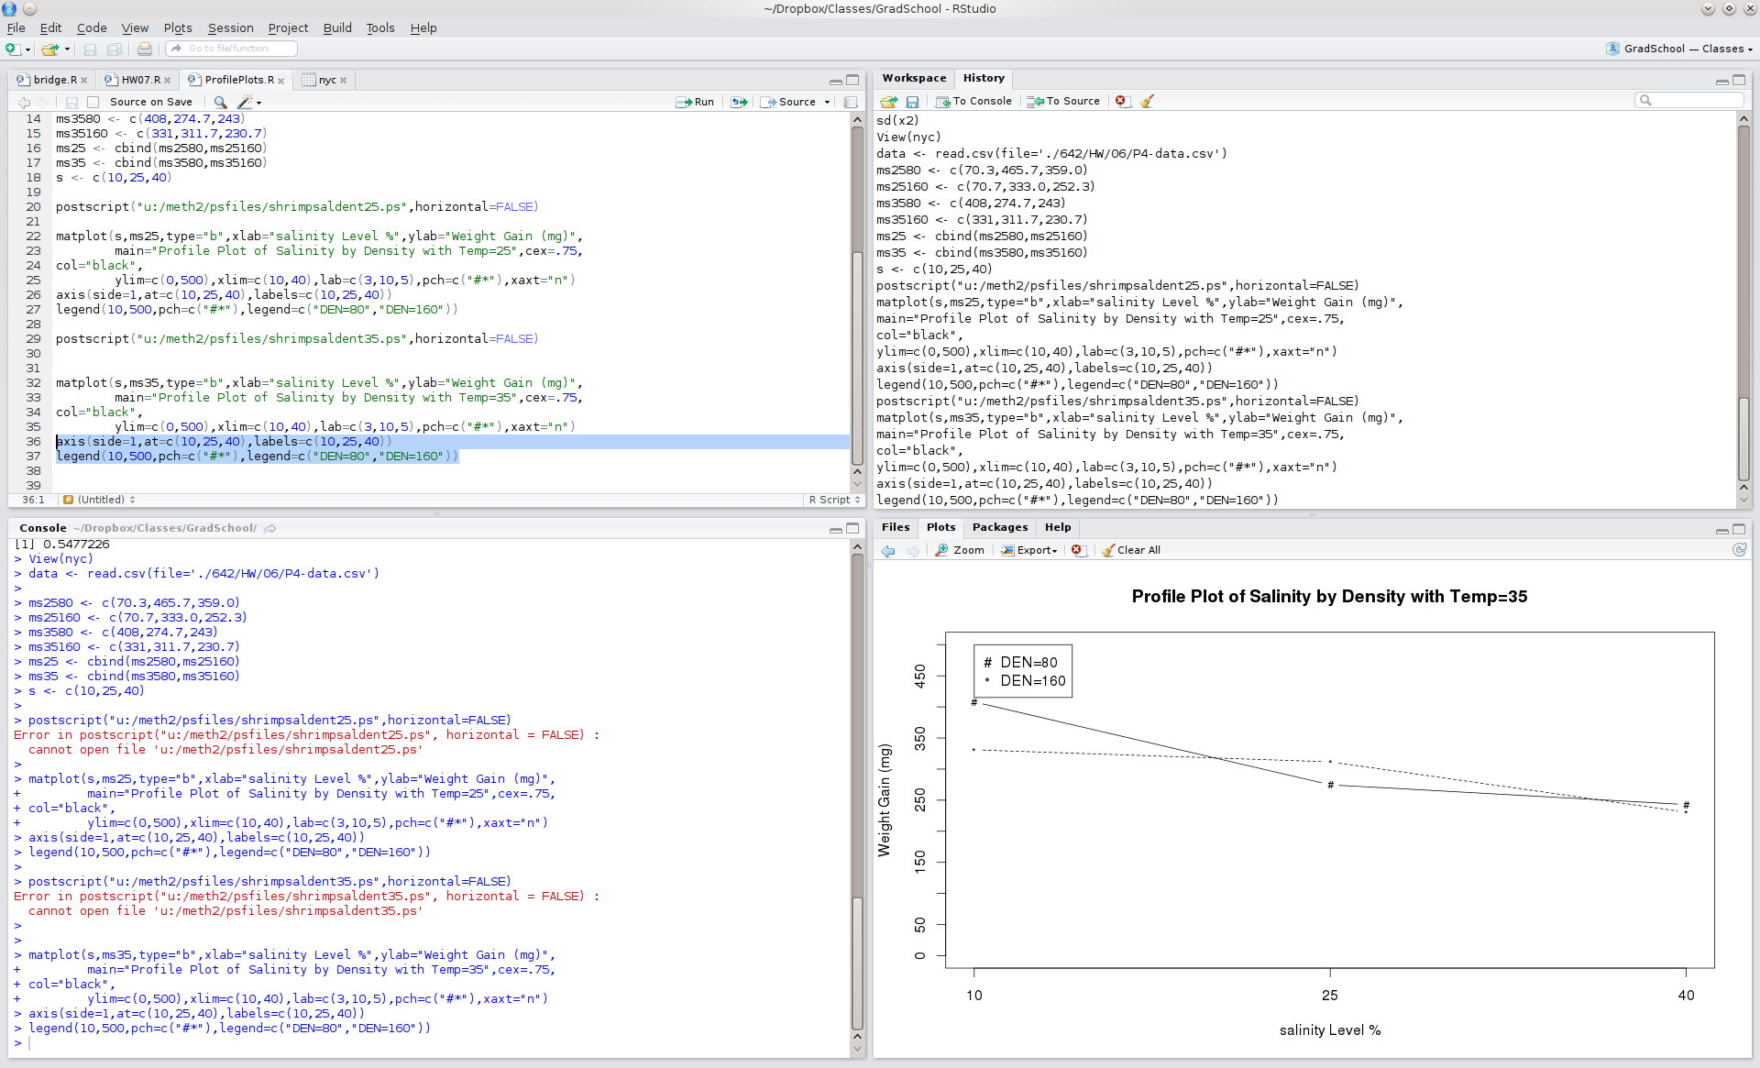
RStudio GUI
Source Editor + Interactive highlight+run
Session History
Interactive Console
Plots Output

Slide 8
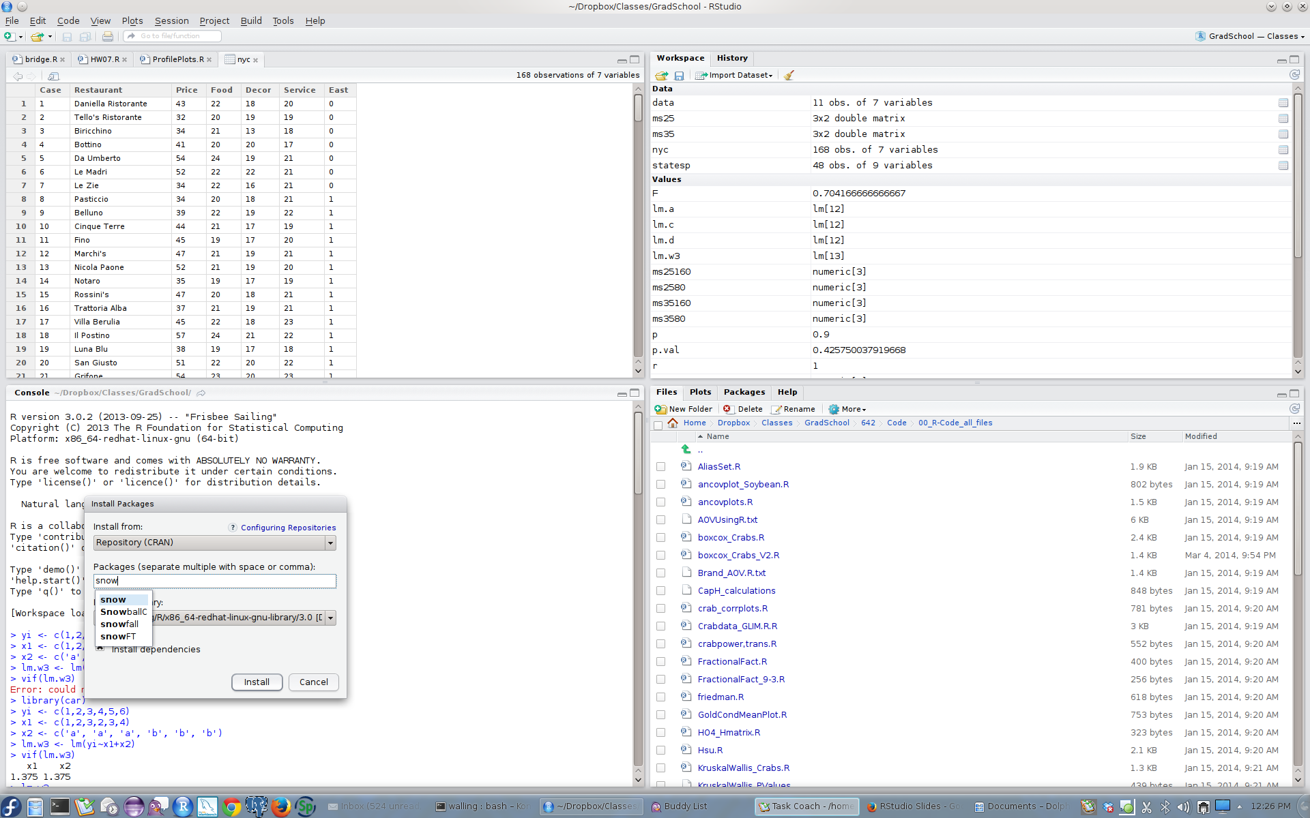
RStudio GUI
Data Viewer
Variable/Environment Viewer
Package Management
File Management

Slide 9
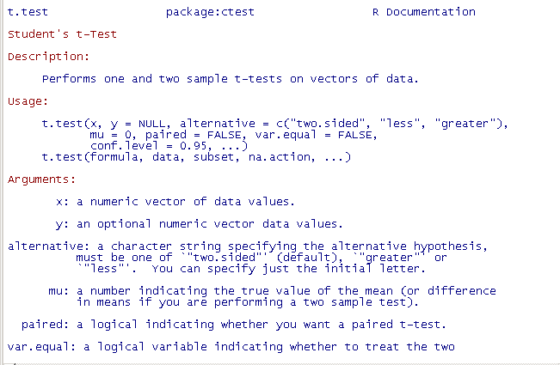
Getting Help
“?” Or “help”
Details about a specific command whose name you know (input arguments, options, algorithm, results):
e.g.
>? t.test
or
>help(t.test)

Slide 10
Basic Syntax

Slide 11
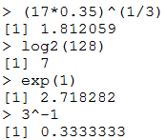
Math Operations
R as a calculator
+, -, /, *, ^, log, exp, …
Notes:
Any questions about R GUI and R Studio?
Now the rest of the first part, I would like to give more introduction on R programming itself to help understanding better of its design concept and functions. For this part, we basiccally just use the interactive console which would be the exactly same regardless what user interface you are using.
First R support numerical operation. You basically can type in numbers, and operations to perform as what you do with a calculator. R environment will parse the input equation and gives you the answer as a calculators. All the function name and symbol used by R to denote different math operation are also following common practices.

Slide 12



Variables
Numeric
Character String
Logical

Slide 13


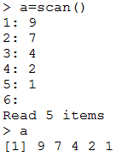


Assigning Values to Variables
“<-” or “=“
Assign multiple values
Combine, c()
Stdin, scan()
Series, seq()

Slide 14

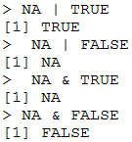

NA: Missing Value
Variables of each data type (numeric, character, logical) can also take the value NA: not available.
NA is not the same as 0
NA is not the same as “”
NA is not the same as FALSE
Any operations (calculations, comparisons) that involve NA may or may not produce NA:
Notes:
A special types in R is NA.

Slide 15
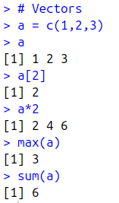
Basic Data Structure
Vector
An ordered collection of data of the same type.
A single number is the special case of a vector with 1 element.
Usually accessed by index.

Slide 16
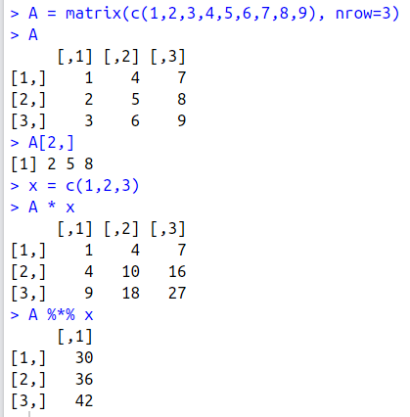
Basic Data Structure
Matrix
Rows, Columns
Single data type
Linear algebra computations

Slide 17
Exercise
Create a vector of integers from 1 to 2016 and sum the result.
Notes:
1: 2033136
2:

Slide 18

Exercise
Create a vector of integers from 1 to 2016 and sum the result.
Notes:
2:

Slide 19
Exercise
Create a vector of integers from 1 to 2016 and sum the result.
Create a 3x3 matrix of i^3 for i = 1 to 9, by row. Sum the 3rd row.
Notes:
1: 2033136
2:

Slide 20

Exercise
Create a vector of integers from 1 to 2016 and sum the result.
Create a 3x3 matrix of i^3 for i = 1 to 9. Sum the 3rd row.
Notes:
1: 2033136
2:

Slide 21
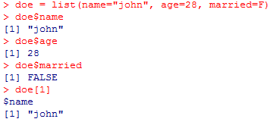
Basic Data Structure
List
an ordered collection of data of arbitrary types.
key-value pair
Accessible by key
Notes:
The concept of List is more or less like an object.
You can also think list as a row within a data table.
So in the example shown here. Conceptually, you can see doe is an object of a class, maybe a person, with three attributes associated with object, name, age, marital status.
Or you can see the values are from one row of a data file. The data file may contains a number of persons, and there are three column of information about that person.
Note, that in the list, you can also specificy the “name” for each value, the name is the name of propoerty, or column name. then you can access the value by specifying the name of that variable.

Slide 22
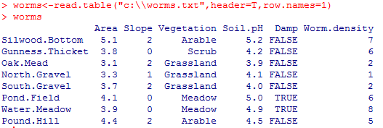
Dataframes
R handles data in objects known as dataframes;
rows: data items;
columns: values of the different attributes
Values in each column should be from the same type.
Notes:
Putting togeter, R can automatically store a set of data in objects known as data frames.

Slide 23
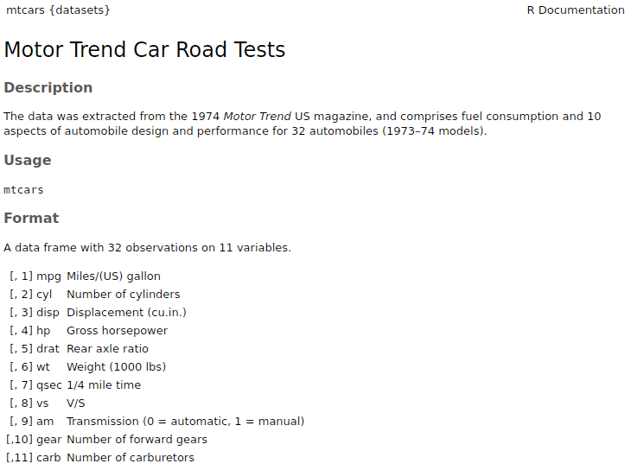
Built In Data Sets
R provides many pre-installed data sets
data()
data(mtcars)
Notes:
Putting togeter, R can automatically store a set of data in objects known as data frames.

Slide 24
Read Dataframes From File
read.table()
worms <- read.table(“worms.txt",header=T,row.names=1)
To see the content of the dataframes (object) just type is name:
> worms
Notes:
Gets arrow .symbol

Slide 25
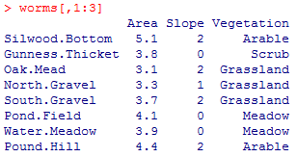
Selecting Data from Dataframes
Subscripts within square brackets
[, means “all the rows” and
,] means “all the columns”
To select the first three column of the dataframe

Slide 26

Selecting Data from Dataframes
names()
Get a list of variables attached to the input name
attach()
Make the variables accessible by name:
> attach(worms)

Slide 27

Selecting Data From Dataframes
Using logic expression while selecting:

Slide 28
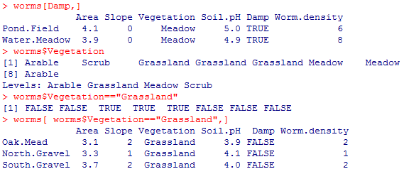
Selecting Data From Dataframes
subset rows by a logical vector
subset a column
comparison resulting in logical vector
subset the selected rows

Slide 29
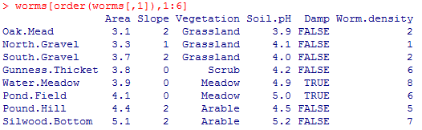
Sorting Data in Dataframes
order()
State columns to be sorted
Notes:
Like the sorting in excel,
Sorting all column based on the column 1.

Slide 30
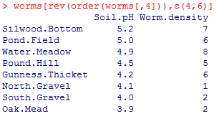
Sorting Data in Dataframes
More on sorting selected
sorted in descending order

Slide 31
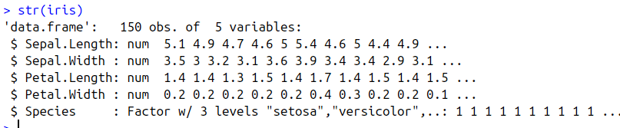
str()
str() provides details on a particular data structure.

Slide 32
Exercise
Load ‘iris’ data set included with R. Find max sepal length.
Notes:
1: 7.9
2:

Slide 33

Exercise
Load ‘iris’ data set. Find max sepal length.
Notes:
1: 7.9
2: 50

Slide 34
Exercise
Load ‘iris’ data set. Find max sepal length.
How many ‘virginica’ species entries
Notes:
1: 7.9
2: 50

Slide 35

Exercise
Load ‘iris’ data set. Find max sepal length.
How many ‘virginica’ species entries?
Notes:
1: 7.9
2: 50

Slide 36
Flow Control
If … else
loops
if (logical expression) {
statements
} else {
alternative statements
}
* else branch is optional
i=1
while(i<=10) {
print(i*i)
i=i+sqrt(i)
}
for(i in 1:10) {
print(i*i)
}

Slide 37
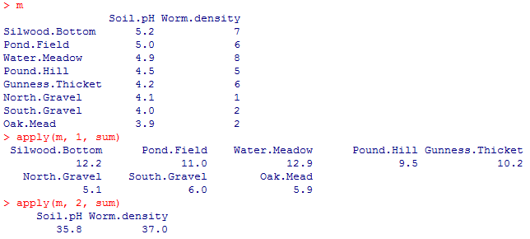
Flow Control
apply (arr, margin, fct )
Applies the function fct along some dimensions of the vector/matrix arr, according to margin, and returns a vector or array of the appropriate size.
Notes:
Can be only applied on matrix, not dataframe directly.
1 is for along row, rowsum
2 is for along column, colsum.

Slide 38
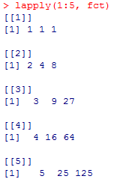

Flow Control
lapply (list, fct) and sapply (list, fct)
To each element of the list li, the function fct is applied. The result is a list whose elements are the individual fct results.
Sapply, converting results into a vector or array of appropriate size

Slide 39
Exercise
Create vector: idx <- c(18, 27, 9, 19, 27, 1, 23, 5, 19, 15, 13, 5). Use ‘sapply’ to return the letter at each index in the included ‘letters’ data structure.
Notes:
R is awesome

Slide 40

Exercise
Create vector: idx <- c(18, 27, 9, 19, 27, 1, 23, 5, 19, 15, 13, 5). Use ‘sapply’ to return the letter at each index in the included ‘letters’ data structure.
Notes:
R is awesome

Slide 41
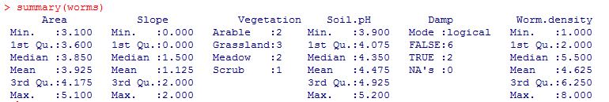
Create Statistical Summary
Descriptive summary for numerical variables:
arithmetic mean;
maximum, minimum, median, 25 and 75 percentiles (first and third quartile);
Levels of categorical variables are counted

Slide 42
Exercise
What is the 1st quantile for sepal width in the ‘iris’ data set.
Notes:
5: 2.8

Slide 43
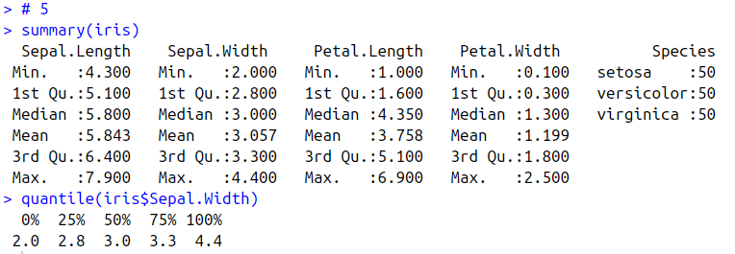
Exercise
What is the 1st quantile for sepal width in the ‘iris’ data set.

Slide 44
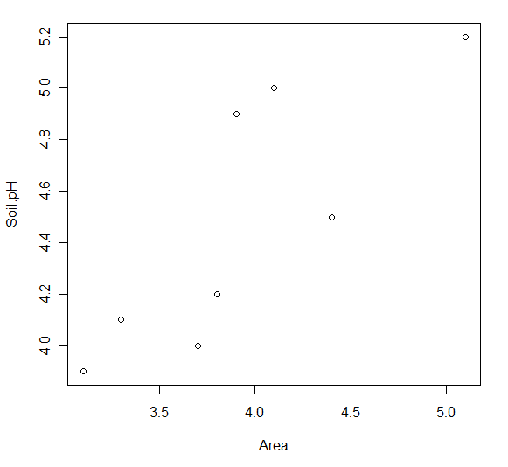
Create Plots
plot(…)
Create scatter plot.
> plot(Area, Soil.pH)

Slide 45
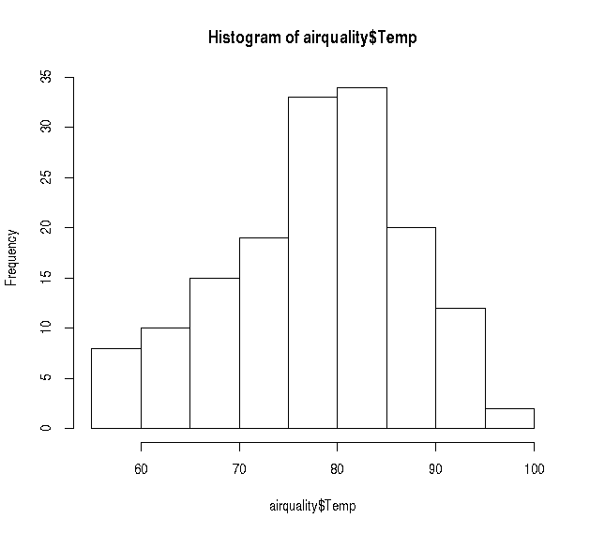
Create Plots
Histograms: visual frequency distributions
> hist(airquality$Temp)

Slide 46
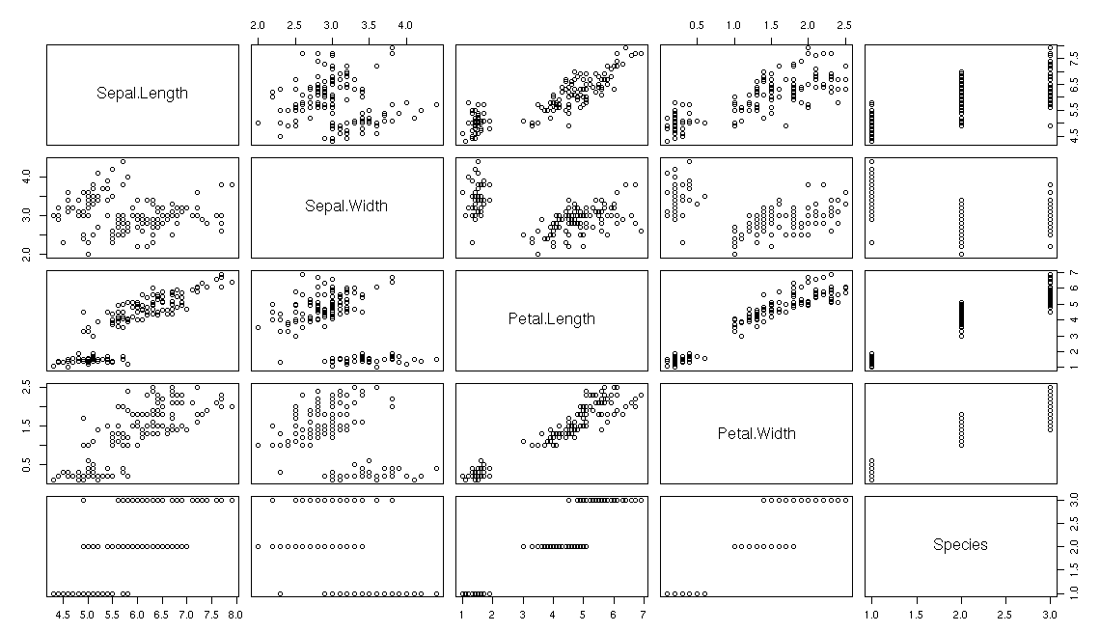
Scatter Plots
plot(iris)

Slide 47
Other Common Plots
Univariate:
histograms,
density curves,
Boxplots, quantile-quantile plots
Bivariate:
scatter plots with trend lines,
side-by-side boxplots
Several variables:
scatter plot matrices, lattice
3-dimensional plots,
heatmap

Slide 48
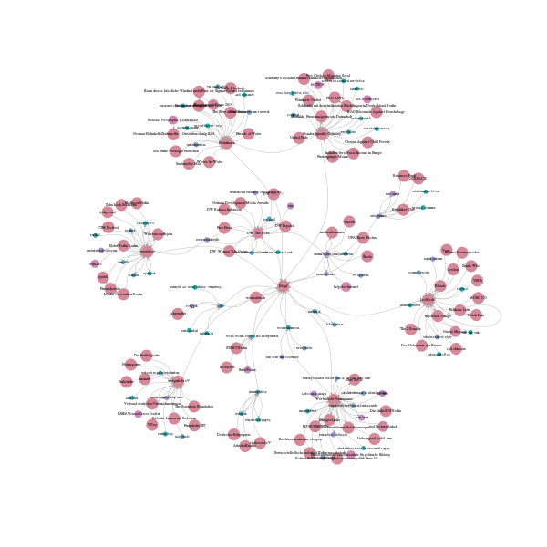
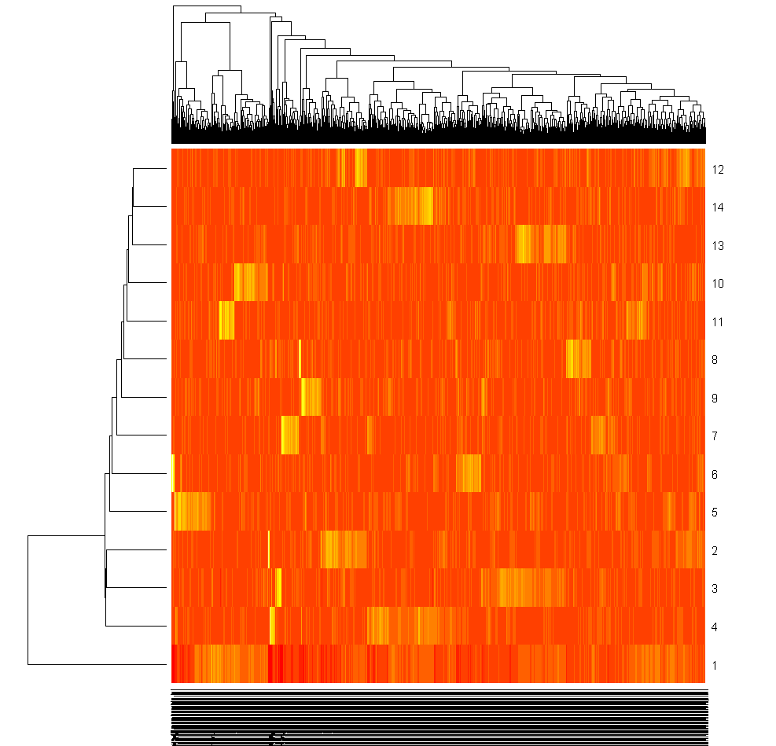
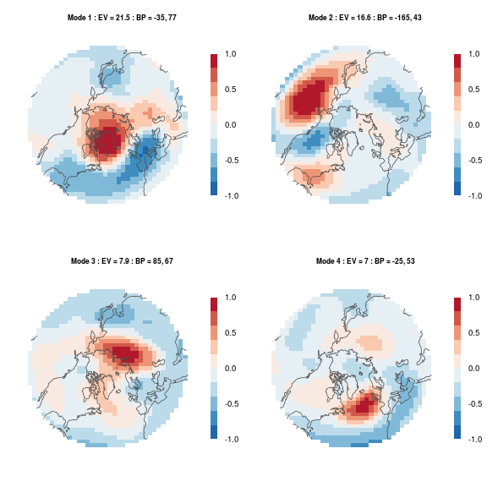
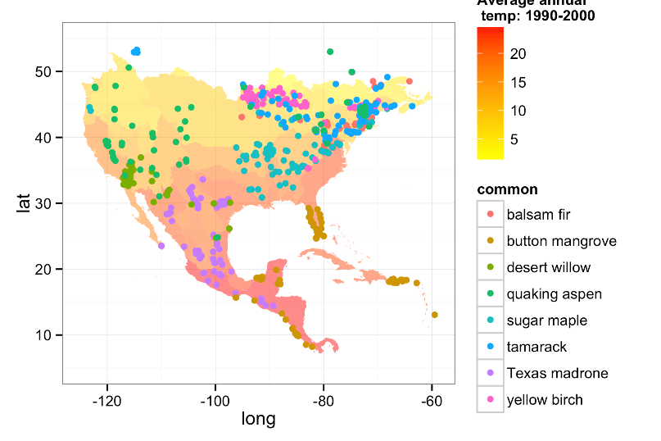
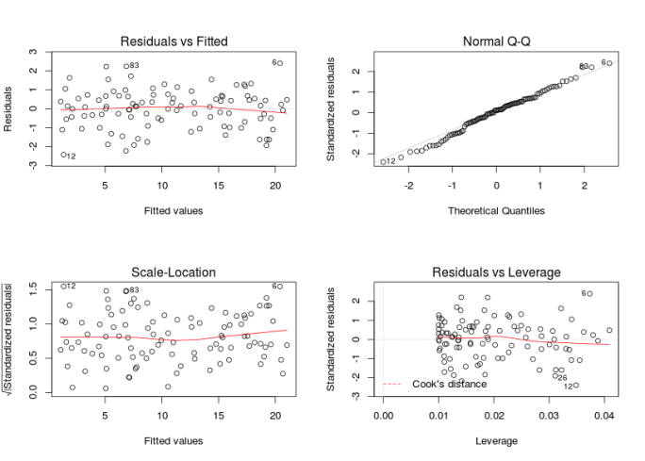

Slide 49
Exercise
Using ‘hist’ plot function, which of the iris numeric variables (Sepal/Petal Width/Length) has the ‘most’ normal-like distribution (i.e. bell curve)?

Slide 50
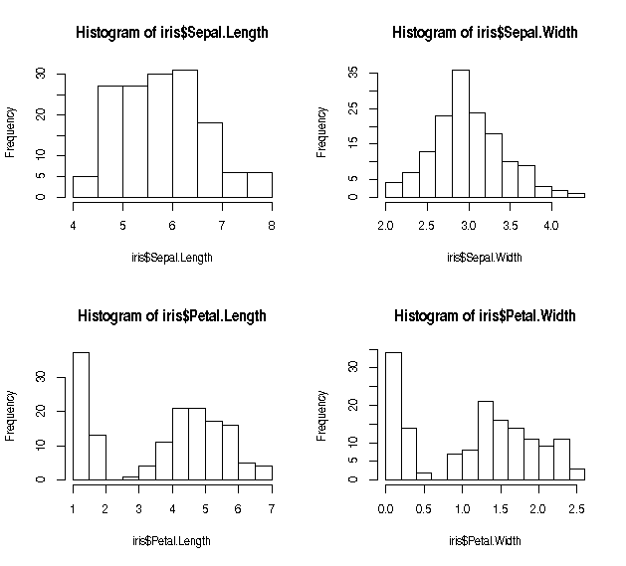
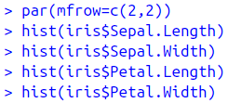
Exercise
Using ‘hist’ plot function, which of the iris numeric variables (Sepal/Petal Width/Length) has the ‘most’ normal-like distribution (i.e. bell curve)?

Slide 51
Importing and Exporting Data
There are many ways to get data into and out of R.
Most programs (e.g. Excel), as well as humans, know how to deal with rectangular tables in the form of tab-delimited text files.
> x = read.delim(“filename.txt”)
also: read.table, read.csv
> write.table(x, file=“x.txt”, sep=“\t”)

Slide 52
Saving Your Work
history(Inf)
To review the command lines entered during the sessions
savehistory(“history.txt”)
Save the history of command lines to a text file
loadhistory(“history.txt”)
read it back into R
save(list=ls(),file=“all.Rdata”)
The session as a whole can be saved as a binary file.
load(“c:\\temp\\ all.Rdata”)
Read back saved sessions.

Slide 53
Additional Libraries and Packages
Libraries
Comes with Package installation (Core or others)
library() shows a list of current installed
library must be loaded before use e.g.
library(rpart)
Packages
Developed code/libraries outside the core packages
Can be downloaded and installed separately
Install.package(“name”)
There are currently 10k+ packages at http://cran.r-project.org/web/packages/

Slide 54
References
Download
https://www.r-project.org
https://www.rstudio.com
R manual
http://cran.r-project.org/manuals.html
Topic Views
https://cran.r-project.org/web/views/
Community Blogs
http://r-bloggers.com
Exercises
https://software-carpentry.org/lessons/
http://swcarpentry.github.io/r-novice-inflammation/01-starting-with-data/index.html

